Slide 1
Django Web Framework

Slide 2
What is Django ?
It is a high-level python web framework used for building fully functioning web applications.
It encourages rapid development and clean pragmatic design.
It is a MVC-style open source collection of libraries.

Slide 3
Why use Django ?
It lets you divide code modules into logical groups to make it flexible to change i.e. MVC style design (MVT).
It provides auto generated web admin to ease the website administration.
It provides pre-packaged API for common user tasks.
It provides template system to define HTML template for your web pages .

Slide 4
What is MVC ?
MVC is a software design pattern for developing web applications.
M – Model ( responsible for managing and maintaining data )
V – View ( takes care what data to show the user )
C – Control ( controls the interaction between model and view )

Slide 5
Django as an MVc – MVT Pattern
MVC is slightly different from MVT as Django itself take care of the controller part.
It leaves the template which is a HTML file mixed with Django Template Language (DTL).

Slide 6
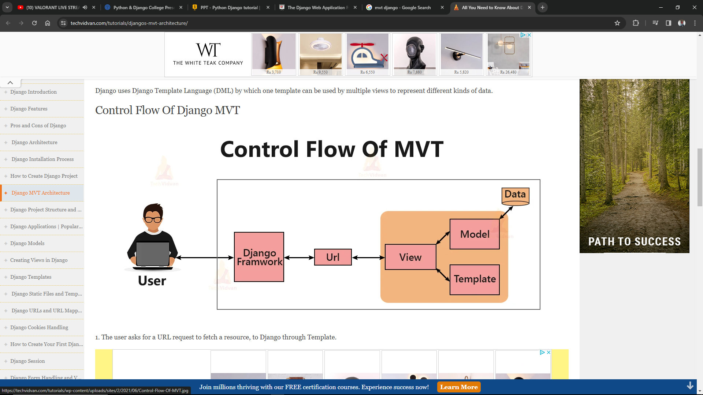
CONTROL FLOW OF MVT

Slide 7
Create a Project
First you need Django installed in your env, if not installed then run this command on cmd: ‘pip install django’
Then navigate to the folder where the project is to be created and run this command : ‘django-admin startproject projectname’

Slide 8
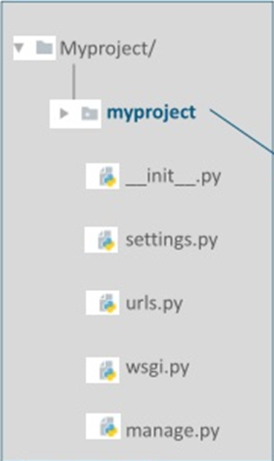
This will create a folder named as projectname with this following structure :
Projectname/
Manage.py
Projectname/
__init__.py
settings.py
urls.py
wsgi.py

Slide 9
Project structure
Manage.py is a command line utility that lets you interact with the django project.
__init__.py means this folder should be treated as a package.
Settings.py contains the settings or configurations of the project .
Urls.py contains the links of your project and the functions to call.
Wsgi.py is an entry point for wsgi-compatible web services.

Slide 10
Development structure
To start the development server , run the command :
‘python manage.py runserver’
Now to start the app run this command :
‘python manage.py startapp appname’

Slide 11
It will create a folder name appname in your project folder, there will be :
Appname/
__init__.py
admin.py
apps.py
models.py
tests.py
views.py
Migrations
__init__.py

Slide 12
Demo…

Slide 13
Thank you :)

